Slide 1


Department of Computer Science and Engineering
BLOCKCHAIN-BASED SECURE FRAMEWORK FOR GOVERNMENT CONSTRUCTION ALLOCATION
KAVYA P B 211419104134
POOJA K 211419104191
Guided by:
Mrs. R DEVI M.E
Coordinator :
Dr.KAVITHA SUBRAMANI M.E,Ph.D

Slide 2
Introduction
There have been numerous attempts to implement the innovation to make government procedures instantaneous and paperless, including web-based tagging frameworks, online tender submission, expense form documentation, and so forth. All of these systems rely on the likelihood of a central server having a weak point because hackers or other malicious users can surely hijack it or interfere with its operation through attacks like DOS, Slow-loris, SYN Flooding, etc. Complex administrative systems in many states frequently result in incredibly wasteful work processes that are full of degradation, errors, and human errors. Data leaks, devaluation, payoffs, and other wrongdoings are included in some administrative procedures like government tenders. The majority of the current electronic services and IT infrastructure have the aforementioned shortcomings, however new developments like blockchain may significantly address the problems we currently face. A permissioned blockchain organisation can provide the crucial simplicity needed to carry out government strategies to assist the nation's citizens and establish liabilities in the event that the framework is improperly used.

Slide 3
Objective of the Project
Block chain innovation is an illustration of such innovation that has been drawing in the consideration of Legislatures across the globe lately. Upgraded security, further developed detectability, and most minimal expense foundation engage the block chain to enter different areas. By and large, legislatures discharge tenders to some outsider associations for various tasks. During this interaction, various contenders attempt to snoop the delicate upsides of others to win the delicate. Block chain strategy utilized under different security administration with various model. It is utilized as backend data set model that keeps up with. No. of clients can enlist and make the delicate citation under different division. Administrator will check and give the reaction from the citation result. Administrator or authority check the experience and interaction of executives’ expertise for broadly useful.

Slide 4
Literature Survey
TITLE | AUTHOR | YEAR | METHODOLOGY | MERITS | FUTURE SCOPE
A Generalized Blockchain-Based Government Data Sharing Protocol | Zilin Liu, Anjia Yang, Huang Zeng, Changkun Jiang, and Li Ma | 2022 | Adaptor signature and zero-knowledge techniques, the proposed protocol ensures a secure and fair data sharing process and is compatible with various blockchains since it only requires the underlying blockchain to perform signature verification. | It would be compatible with a wide variety of blockchains. DE-MERITS: These data are widely stored in different units, departments, and network environments so it is difficult for them to be shared between departments. | Tool to realize the malicious party that cannot obtain more information than the transaction signature, which prevents him from further analysis of the transactions and protects the users’ privacy.

Slide 5
Literature Survey
TITLE | AUTHOR | YEAR | METHODOLOGY | MERITS | FUTURE SCOPE
A Blockchain and Edge-Computing-Based Secure Framework for Government Tender Allocation | Vikas Hassija , Vinay Chamola, Dara Nanda Gopala Krishna , Neeraj Kumar | 2021 | Consensus algorithm,AES and iterative auction algorithm. Using Ethereum, we can control data access by the network nodes based on identity authentication. Only the nodes that are allowed to view or verify the particular data get access to the files. | We have used Ethereum to implement the end-to-end edge computing framework for a government tender workflow. DEMERITS: It takes to long time to process the data with less efficiency. | To store the digital data without any co-related or misreported because the loss of digital data would be much more than the harm that was faced due to the loss of physical files.

Slide 6
Literature Survey
TITLE | AUTHOR | YEAR | METHODOLOGY | MERITS AND DE-MERITS | FUTURE SCOPE
A Generalized Blockchain-Based Government Data Sharing Protocol | Zilin Liu, Anjia Yang, Huang Zeng, Changkun Jiang, and Li Ma | 2022 | Adaptor signature and zero-knowledge techniques, the proposed protocol ensures a secure and fair data sharing process and is compatible with various blockchains since it only requires the underlying blockchain to perform signature verification. | It would be compatible with a wide variety of blockchains. DE-MERITS: These data are widely stored in different units, departments, and network environments so it is difficult for them to be shared between departments. | Tool to realize the malicious party that cannot obtain more information than the transaction signature, which prevents him from further analysis of the transactions and protects the users’ privacy.

Slide 7
Problem Statement
We aim to address these issues to build a transparent and secure edge computing infrastructure for the allocation of government tenders which not only eliminates the need for human supervision or intervention but also makes it easy for the government to keep track and update its policies as time progresses.
To solve this issue, we propose the framework to use blockchain technology for creating a decentralized system to perform government tendering processes with ease, transparent, auditable, and immutable.

Slide 8
Proposed System
A permissioned blockchain network can provide the necessary transparency to effectively implement government policies for the benefit of the citizens of the country and fix responsibilities in case of abuse of the system.
Hash Function – SHA 256 algorithm:
It takes a piece of information and passes it through the function that performs mathematical operations on the plaintext . This function is called hash function.
It gives convenience to identify and compare the data.
Data transfer takes less time.
We propose the framework to use blockchain technology for creating a decentralized system to perform government tendering processes with ease, transparent, auditable, and immutable.

Slide 9
Software / Hardware used
HARDWARE REQUIREMENTS:
Processor : PENTIUM IV 2.6 GHz, Intel Core 2 Duo.
RAM : 4GB DD RAM
Hard disk : 40 GB
SOFTWARE REQUIREMENTS:
Front End : J2EE (JSP, SERVLETS) JAVASCRIPT
Back End : MY SQL 5.5
Operating System : Windows 10
IDE : Eclipse

Slide 10
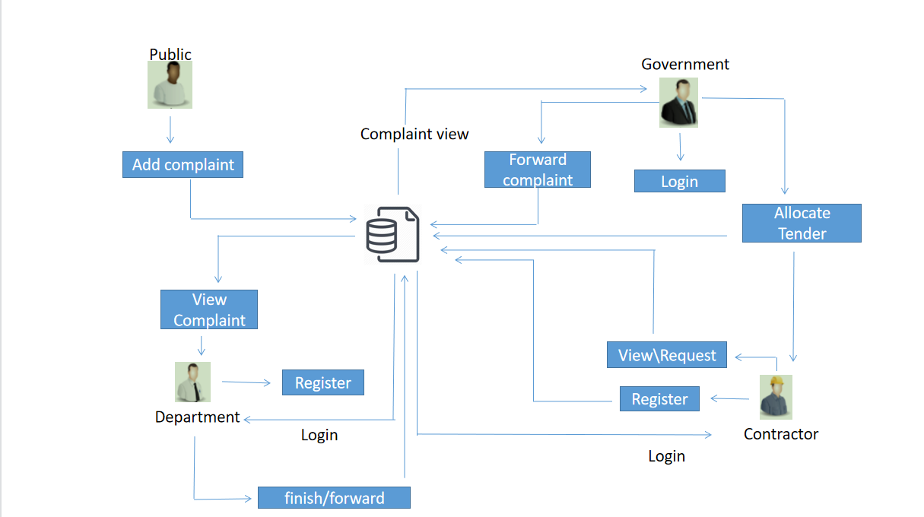
System Architecture

Slide 11
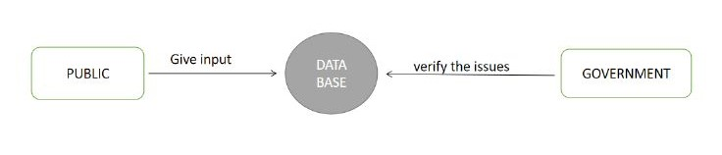
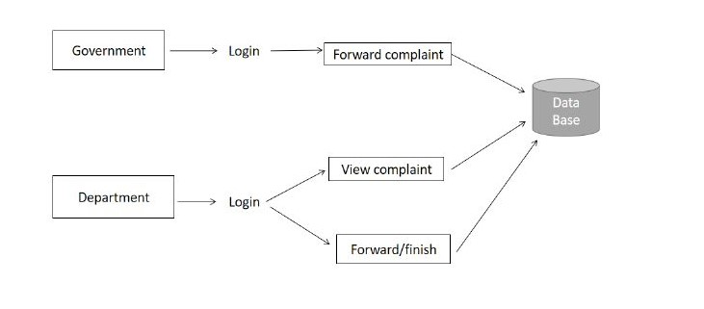
System Design
DATAFLOW DIAGRAM:
LEVEL 0:
LEVEL 1:

Slide 12
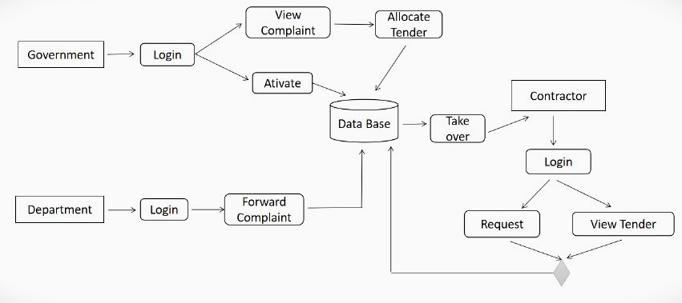
System Design
LEVEL 2:

Slide 13
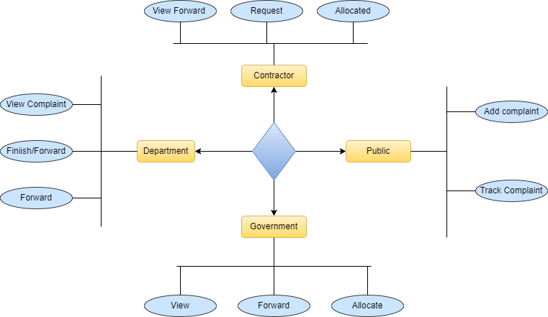
System Design
E-R DIAGRAM:

Slide 14
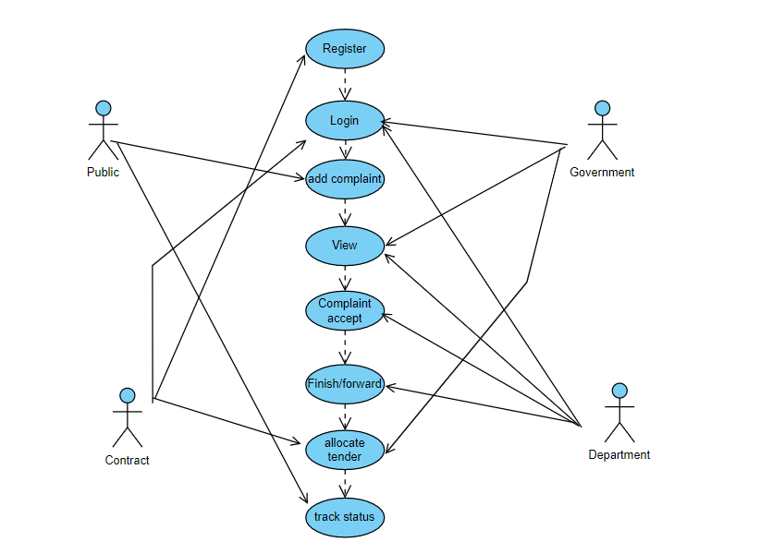
System Design
USE CASE DIAGRAM:

Slide 15
Module Description
1.PUBLIC REGISTER:
The register module provides a conceptual framework for entering data on those department in a way that: eases data entry & accuracy by matching the department entry to the data source (usually paper files created at point of care), ties easily back to individual department records to connect registers to department data, and collects data elements to enable better supervision of tender programs.
2.DEPARTMENT LOGIN:
In this module in our project, here symbolizes a unit of work performed within a database management system (or similar system) against a database, and treated in a coherent and reliable way independent of other transactions. A transaction generally represents any change in database user will transfer the amount to provider.
3.GOVERNMENT LOGIN:
In this module in our project, here symbolizes a unit of work performed within a database management system (or similar system) against a database, and treated in a coherent and reliable way independent of other transactions. A transaction generally represents any change in database user will transfer the amount to provider.

Slide 16
Module Description
4.GOVERNMENT TENDER ALLOCATION:
In this module the government will allocate the tender for the government project. Analysis the details will be responsible for your file stored in database.
5.CONTRACTOR LOGIN:
In this module in our project, here symbolizes a unit of work performed within a database management system (or similar system) against a database, and treated in a coherent and reliable way independent of other transactions. A transaction generally represents any change in database user will transfer the amount to provider.

Slide 17
Module Description
MODULE DIAGRAM:
1.PUBLIC REGISTER
DATABASE
REGISTER
2.DEPARTMENT LOGIN
LOGIN
DATABASE
HOMEPAGE
DEPARTMENT
3.GOVERNMENT LOGIN
DATABASE
GOVERNMENT
LOGIN
HOMEPAGE

Slide 18
Module Description
4.GOVERNMENT TENDER ALLOCATION
GOVERNMENT
ALLOCATE TENDER
DATABASE
CONTRACTOR
5.CONTRACTOR LOGIN
CONTRACTOR
LOGIN
DATABASE
HOMEPAGE

Slide 19
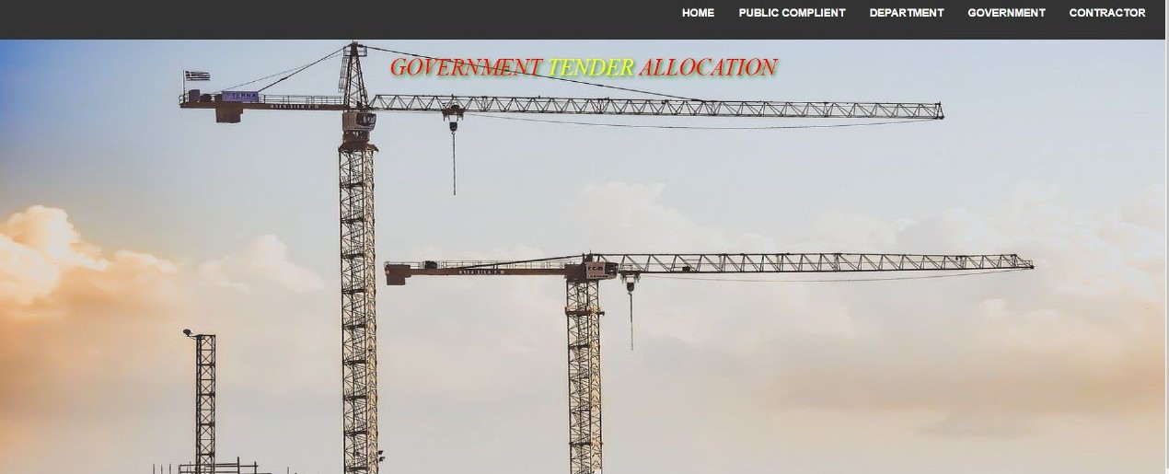

Screen Shots
1.HOME PAGE
2.PUBLIC COMPLAINT PAGE

Slide 20
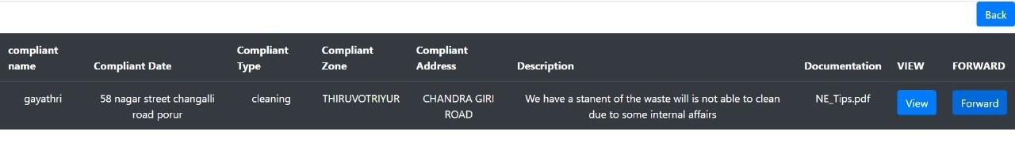
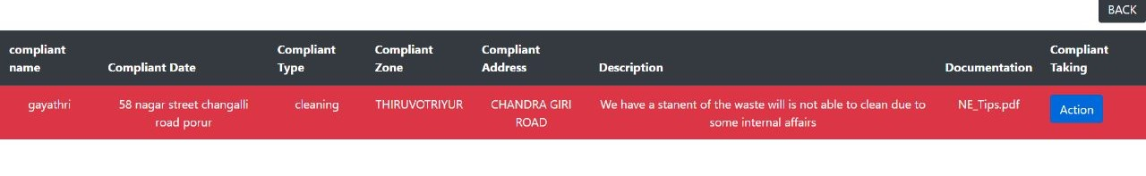
Screen Shots
3.GOVERNMENT VIEW
4.DEPARTMENT LOGIN
5.DEPARTMENT VIEW

Slide 21
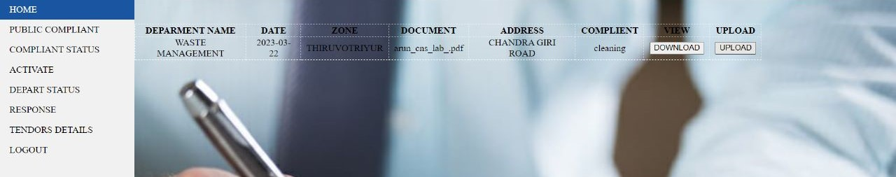
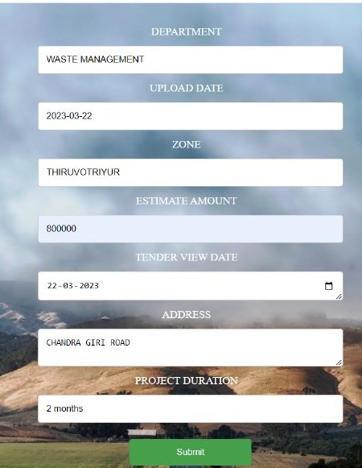
Screen Shots
6.GOVERNMENT WILL GET A RESPONSE FROM THE DEPARTMENT
7.GOVERNMENT ALLOCATE TENDER

Slide 22
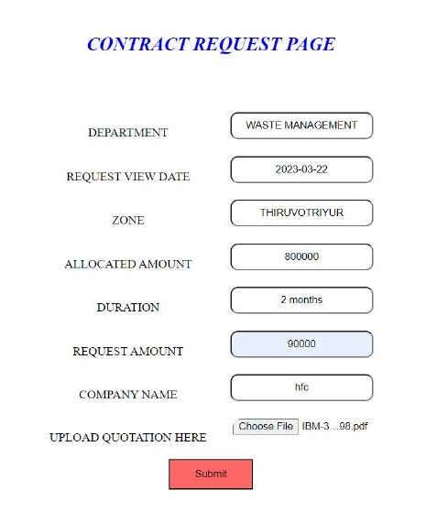
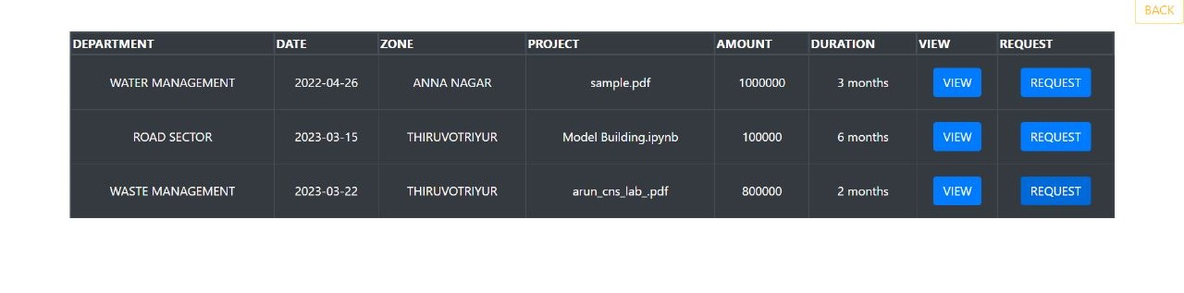
Screen Shots
8.CONTRACTOR LOGIN AND REQUEST TO TENDER
9.GOVERNMENT ACCEPTS THE CONTRACTOR REQUEST

Slide 23
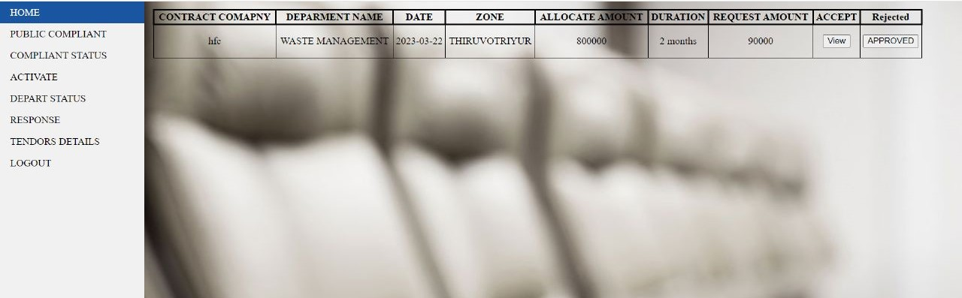
Screen Shots
10.GOVERNMENT VIEW AND PUBLIC CAN CHECK THE TENDER PROCESS

Slide 24
Conclusion
In this article, we have talked about on the need and advantages of utilizing block chain innovation in the public authority delicate task process. We have used to execute the start to finish edge processing system for an administration delicate Work process. The SHA calculation is proposed to relate the most appropriate constructors to the delicate undertakings, subsequently improving the benefit of both the public authority Tenders and the development organizations. We have likewise concentrated on the presentation assessment of the proposed model. The proposed model demonstrates to give improved brings about terms of various delicate boundaries when contrasted with its partners.
Future Enhancement
. Implementing a certifiable information base framework to the public authority projects.
Improving the proficiency of conventions, regarding number of delicate traded and in wording.
3. Implement using two are more algorithms

Slide 25
Reference Paper
[1] V. Hassija, V. Chamola, V. Saxena, D. Jain, P. Goyal, and B. Sikdar, “A survey on IoT security: Application areas, security threats, and solution architectures,” IEEE Access, vol. 7, pp. 82721–82743, 2019.
[2] A. Alketbi, Q. Nasir, and M. A. Talib, “Blockchain for government services—Use cases, security benefits and challenges,” in Proc. IEEE 15th Learn. Technol. Conf. (L&T), 2018, pp. 112–119.
[3] coindesk. The Indian Government Is Preparing a National Framework to Support the Wider Deployment of Blockchain Use Cases. Accessed: Nov. 27, 2019. [Online]. Available: https://www.coindesk.com/indiaplans- to-issue-a-national blockchain-framework
[4] H. Cho, “Correction to asic-resistance of multi-hash proof-of-work mechanisms for blockchain consensus protocols,” IEEE Access, vol. 7, 2019, Art. no. 25086.
[5] V. Hassija, V. Chamola, S. Garg, N. G. K. Dara, G. Kaddoum, and D. N. K. Jayakody, “A blockchain-based framework for lightweight data sharing and energy trading in V2G network,” IEEE Trans. Veh. Technol., vol. 60, no. 6, pp. 5799 5812, Jun. 2020.
[6] V. Hassija, V. Chamola, D. N. G. Krishna, and M. Guizani, “A distributed framework for energy trading between UAVs and charging stations for critical applications,” IEEE Trans. Veh. Technol., vol. 69, no. 5, pp. 5391–5402, May 2020.
[7] E. Androulaki et al., “Hyperledger fabric: A distributed operating system for permissioned blockchains,” in Proc. ACM 13th EuroSys Conf., 2018, p. 30.
[8] V. Hassija, V. Chamola, G. Han, J. J. Rodrigues, and M. Guizani, “DAGIoV: A framework for vehicle to vehicle communication using directed acyclic graph and game theory,” IEEE Trans. Veh. Technol., vol. 69, no. 4, pp. 4182–4191, Jan. 2020.

